Slide 1
Project title
Proponent

Slide 2
The challenge
Define the application area
What problem are you addressing? What is the need you are satisfying?
How did you identify this challenge? Do you have input from the relevant user/producer community? (e.g. medical doctors, aeronaticaul industry,…)

Slide 3
The project /1
1-slide description of the project
Including which is the CERN tech/know-how on which the project is based
Tell us about the team who is going to drive the project (internal & external experts involved), Intellectual Property considerations if relevant

Slide 4
The project /2
Funding (with timeline)
Contributions from the partners, if there are any
Deliverables
Possible go/no-go checkpoints

Slide 5
Impact
Return on Investment [see next slide for guidelines on how to fill this]
Market potential
Roadmap to industrialization
Likelihood of revenues (important to ensure a healthy cash flow to the KT Fund, for future projects)
Other
Societal impact
Addresses Sustainable Development Goals (SDGs - https://sdgs.un.org/goals)?
Useful (also) for CERN internal use?

Slide 6
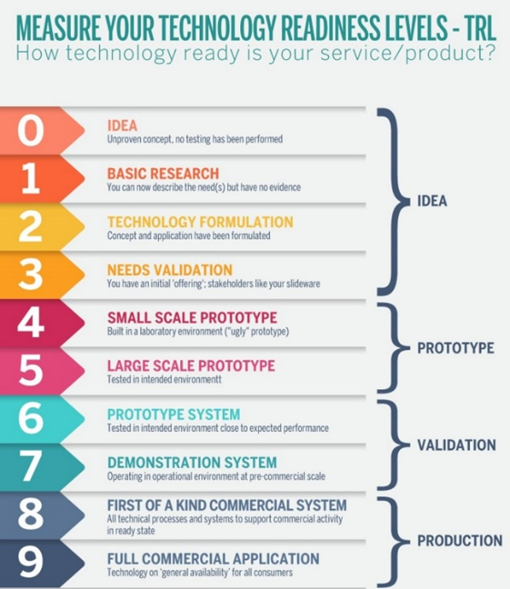
Questions to help you define Return on investment and fill the previous slide:
Competing technologies
What is already available on the market, and how your project will make a difference
What would be the TRL at the beginning and end of the project?
If the project is successful, what would be the dissemination route(s)? (e.g. creation of a start-up by members of the project team, technology made available for CERN Venture Connect, licence to existing companies…)
What is the likelihood that the project will bring revenues, and on which timescale? (particularly relevant for the KT Fund, that is fueled by revenues)
What could hinder uptake from industry? (e.g. cost of the technology, size of the market, long time for deployment…)

Slide 7
How does success look like…
At the end of the project?
In the medium and/or longer term?

